Slide 1


Back-End Programming: Flask
Advanced Programming – 1401-2

Slide 2
What is Back-End Programming
برنامه‌نویسی بک‌اند به توسعه قسمت سرور یک وب‌سایت یا برنامه اشاره دارد. بخش بک‌اند شامل سرور، پایگاه داده و منطق برنامه است که با همکاری ارائه‌دهنده خدمات به کاربر، امکان‌های مورد نیاز را فراهم می‌کند.
برنامه‌نویسان بک‌اند از زبان‌های برنامه‌نویسی مانند جاوا، پایتون، روبی، پی‌اچ‌پی و زبان‌های دیگر استفاده می‌کنند تا کدی بنویسند که با سرور و پایگاه داده ارتباط برقرار کند و داده‌ها را بازیابی، ذخیره و تغییر دهد. آن‌ها مسئول ایجاد منطق و الگوریتم‌هایی هستند که به برنامه امکان عملکرد صحیح را می‌دهند، مانند مدیریت تأیید هویت کاربر، مدیریت نشست‌ها، پردازش داده و پاسخ به درخواست‌های مبتنی بر مقدار ورودی کاربر در بخش کاربردی.
برنامه‌نویسی بک‌اند همچنین شامل اطمینان از امنیت برنامه و محافظت در برابر آسیب‌پذیری‌های ممکن، و بهینه‌سازی عملکرد سرور و پایگاه داده برای اطمینان از اینکه برنامه می‌تواند تعداد زیادی کاربر و درخواست را پشتیبانی کند، می‌باشد. در کل، برنامه‌نویسی بک‌اند یک قسمت بسیار حیاتی از فرایند توسعه نرم‌افزار است که امکان ایجاد برنامه‌های وب پایدار و مقیاس‌پذیر را فراهم می‌کند.

Slide 3
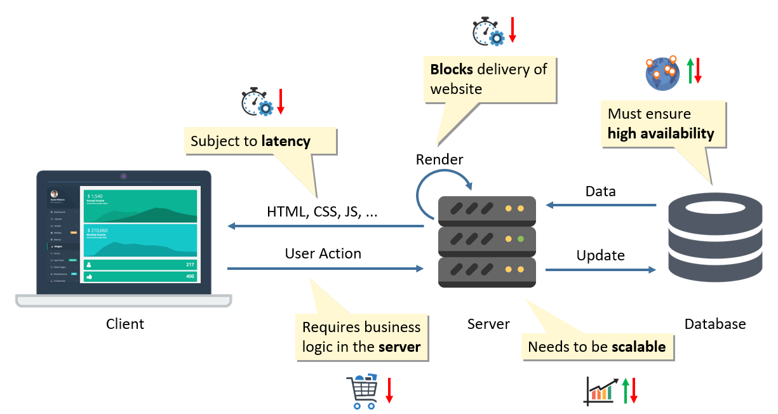
Relation Between Client Server And Database

Slide 4
What is Back-End Programming
Flask and Django are popular Python web frameworks used for developing web applications.
Flask is a micro web framework that is lightweight and easy to learn. It provides only the bare essentials for web development and allows developers to add on additional functionality as needed. Flask is popular among developers for its simplicity and flexibility, and it is often used for building small to medium-sized web applications.
Django, on the other hand, is a full-stack web framework that provides everything needed for web development out of the box, including an ORM (Object-Relational Mapping) system, a templating engine, and an administrative interface. Django is designed to be more opinionated and follows a "batteries included" philosophy, which means that it provides many built-in features and is suitable for building complex and large-scale web applications.
Both Flask and Django are widely used in the Python community and have their own advantages and disadvantages. Flask is more suitable for smaller and simpler projects where developers need more control and flexibility, while Django is better for larger and more complex projects where developers need a more robust set of tools and feature

Slide 5
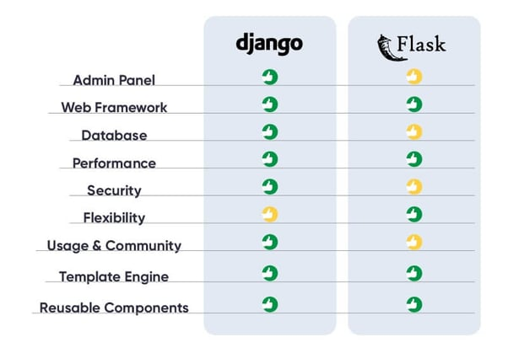
Flask vs Django

Slide 6







Flask vs Django

Slide 7
Types of Requests
HTTP (Hypertext Transfer Protocol) is a protocol used by web browsers and servers to communicate and transfer data over the internet. HTTP requests are a way for a client (e.g., a web browser) to request a resource from a server, such as a web page or an image.
There are several types of HTTP requests, but the most common are GET, POST, PUT, and DELETE:
GET: A GET request is used to retrieve a resource from the server. When a user types a URL into their web browser, the browser sends a GET request to the server for the resource at that URL. The server then responds with the requested resource, usually a web page.
POST: A POST request is used to submit data to the server, usually for processing or storing. For example, when a user submits a form on a web page, the browser sends a POST request to the server with the form data in the request body.
PUT: A PUT request is used to update a resource on the server. For example, a user might use a PUT request to update their profile information on a web application.
DELETE: A DELETE request is used to delete a resource from the server. For example, a user might use a DELETE request to delete a post or comment on a social media application.
HTTP requests also include headers, which provide additional information about the request, such as the user agent (the browser or client making the request), the type of data being sent or requested (e.g., text, JSON, or an image), and any cookies or authentication tokens that the server might require.
In summary, HTTP requests are a way for clients to request resources from servers and communicate with web applications. The most common types of requests are GET, POST, PUT, and DELETE, and they are accompanied by headers that provide additional information about the request.

Slide 8
Types of Requests
HTTP (Hypertext Transfer Protocol) is a protocol used by web browsers and servers to communicate and transfer data over the internet. HTTP requests are a way for a client (e.g., a web browser) to request a resource from a server, such as a web page or an image.
There are several types of HTTP requests, but the most common are GET, POST, PUT, and DELETE:
GET: A GET request is used to retrieve a resource from the server. When a user types a URL into their web browser, the browser sends a GET request to the server for the resource at that URL. The server then responds with the requested resource, usually a web page.
POST: A POST request is used to submit data to the server, usually for processing or storing. For example, when a user submits a form on a web page, the browser sends a POST request to the server with the form data in the request body.
PUT: A PUT request is used to update a resource on the server. For example, a user might use a PUT request to update their profile information on a web application.
DELETE: A DELETE request is used to delete a resource from the server. For example, a user might use a DELETE request to delete a post or comment on a social media application.
HTTP requests also include headers, which provide additional information about the request, such as the user agent (the browser or client making the request), the type of data being sent or requested (e.g., text, JSON, or an image), and any cookies or authentication tokens that the server might require.
In summary, HTTP requests are a way for clients to request resources from servers and communicate with web applications. The most common types of requests are GET, POST, PUT, and DELETE, and they are accompanied by headers that provide additional information about the request.

Slide 9
Response Codes
HTTP (Hypertext Transfer Protocol) response codes are three-digit numbers that indicate the outcome of an HTTP request made by a client (e.g., a web browser) to a server. There are five categories of HTTP response codes, each with a different first digit:
Informational responses (1xx): These codes indicate that the server has received the request and is continuing to process it. Examples include 100 Continue (the client should continue with the request) and 101 Switching Protocols (the server is switching to a different protocol, such as HTTP/2).
Successful responses (2xx): These codes indicate that the request was successful and the server was able to process it. The most common code is 200 OK (the request was successful and the server is returning the requested data), but there are other codes such as 201 Created (the server has created a new resource), 204 No Content (the server has processed the request but is not returning any data), and 206 Partial Content (the server is returning only part of the requested data).
Redirection responses (3xx): These codes indicate that the client needs to take additional action to complete the request. Examples include 301 Moved Permanently (the requested resource has been permanently moved to a new URL), 302 Found (the requested resource has been temporarily moved to a new URL), and 307 Temporary Redirect (the requested resource has been temporarily moved to a new URL).
Client error responses (4xx): These codes indicate that there was an error with the client's request. Examples include 400 Bad Request (the server could not understand the request), 401 Unauthorized (the client needs to provide authentication credentials), 404 Not Found (the requested resource could not be found), and 429 Too Many Requests (the client has sent too many requests in a given amount of time).
Server error responses (5xx): These codes indicate that there was an error with the server while processing the request. Examples include 500 Internal Server Error (an unexpected error occurred on the server), 503 Service Unavailable (the server is currently unavailable), and 504 Gateway Timeout (the server did not receive a timely response from an upstream server).
HTTP response codes provide a standardized way for servers to communicate the outcome of requests to clients. They are an important part of the HTTP protocol and are used by web developers and server administrators to troubleshoot issues and optimize performance.

Slide 10
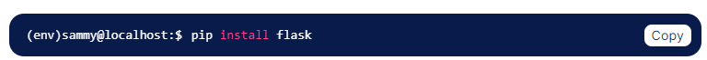
How to Create Flask Apps #step 1
Installing Flask

Slide 11
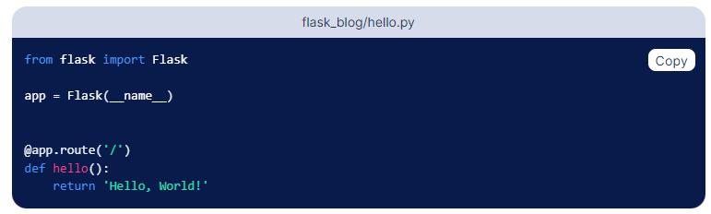
How to Create Flask Apps #Step 2
Creating a Base Application

Slide 12
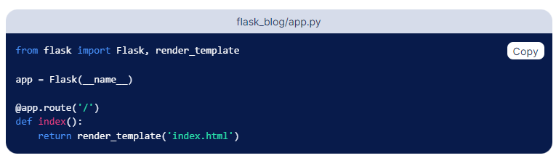
How to Create Flask Apps #Step 3
Render Template

Slide 13
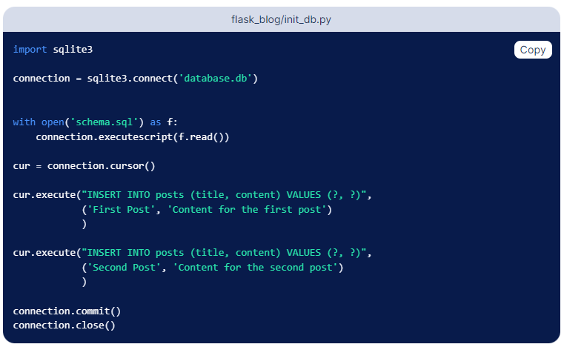
How to Create Flask Apps #Step 4
Create Database

Slide 14
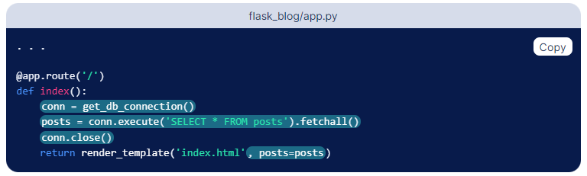
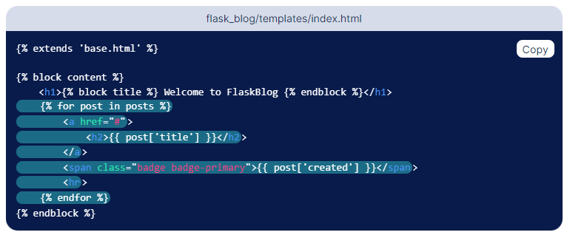
How to Create Flask Apps #Step 5
Send Data To Front

Slide 15
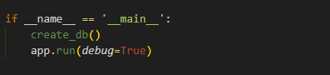
How to Create Flask Apps #Step 6
Run The App

Slide 16
A Simple Project
Now Lets Build a simple project and analyze it

Slide 17
Lets Build Delete Function
Task.query.get_or_404({{id}})
db.session.delete({{data}})
db.session.commit({{null}})
redirect(url_for({{function}}))

